Slide 1

- Unlocking NHS Potential - A Data-Driven Story of GP Capacity in England
Tilani Wijamunige - Data Analyst – 12/08/2024

Slide 2

ON THE NEWS
“While it is frustrating when patients do not attend, the reasons why this happens should be investigated rather than simply resorting to punishing them. Financially penalising patients inevitably impact the poorest and most vulnerable in the community”
(GP Practice News 2022)

Slide 3
OBJECTIVES
- Assess opportunities for optimising GP appointment availability.
- Evaluate the utilisation of NHS GP resources
TO EXPLORE
What are the seasonal / Regional trends in GP appointments and attendance?
How do healthcare roles and consultation methods affect GP services?
How can social media like Twitter / X be used for service improvements?

Slide 4
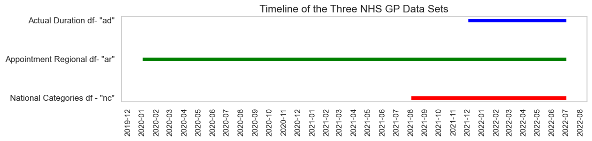
DATA TIMELINE

Slide 5
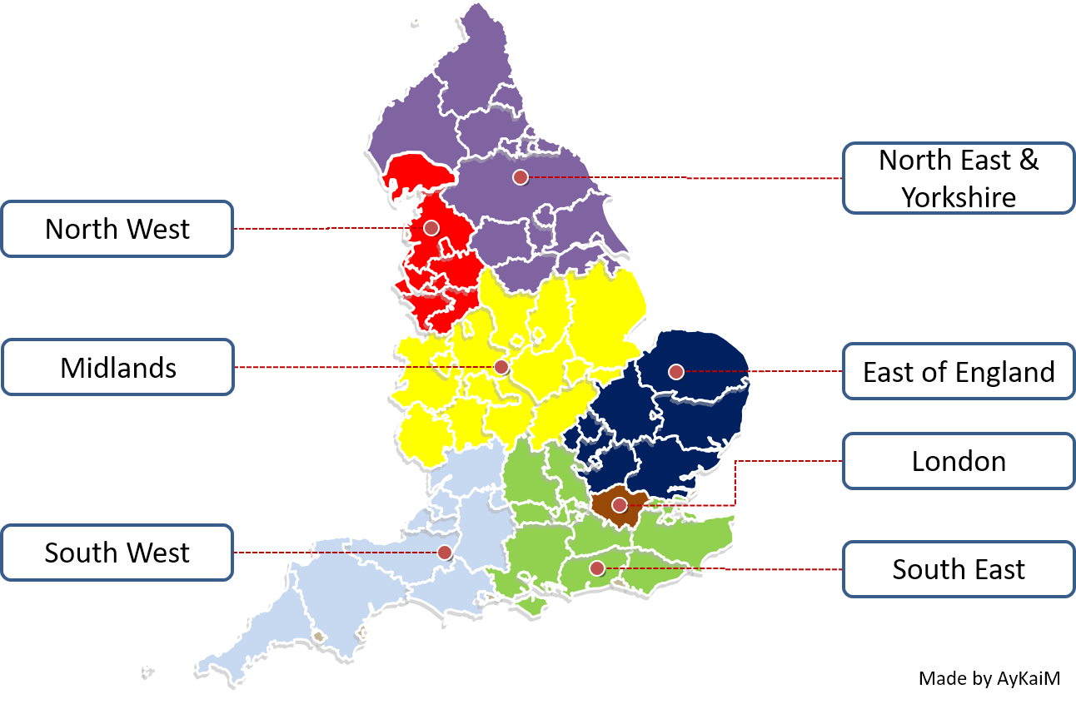
NHS ENGLAND REGIONS
NHS England is divided into
7 regions
42 Integrated Care Boards (ICBs)
106 Sub-ICBs.
Image courtesy: https://aykaim.home.blog/2019/06/17/mergers-nhs-england-and-improvement/

Slide 6
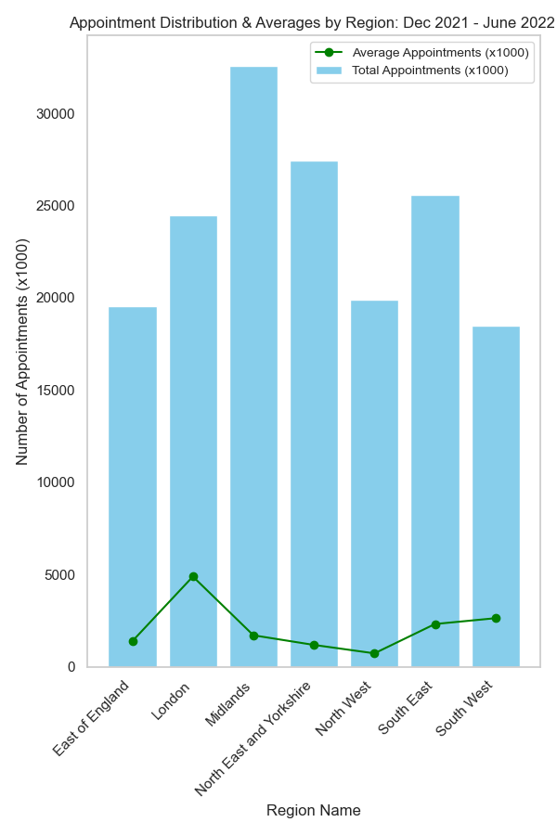
REGIONAL DATA Dec 21 – June 22
Between December 2021 and June 2022, a total of 167,980,692 GP appointments were reported.
London : highest average
Midlands : highest total
Regional Differences
Population
Service demand
Infrastructure
Resource allocation
seasonal factors
data inconsistencies

Slide 7
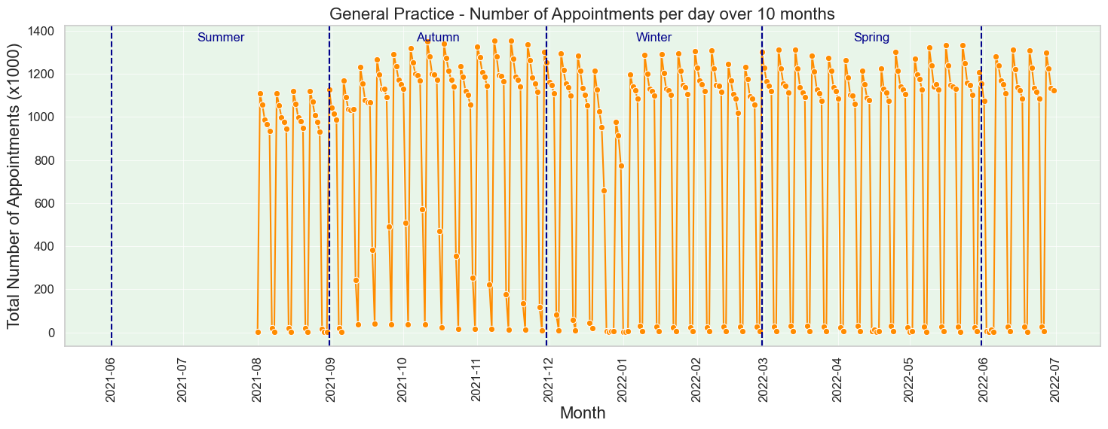
SESONAL DATA Jan 20 – June 22
300 million GP appointments recorded
Slight Autumn increase and mid-winter decline
Weekly drops in appointments were consistent
GP practices handled high volumes, managing steady demand

Slide 8
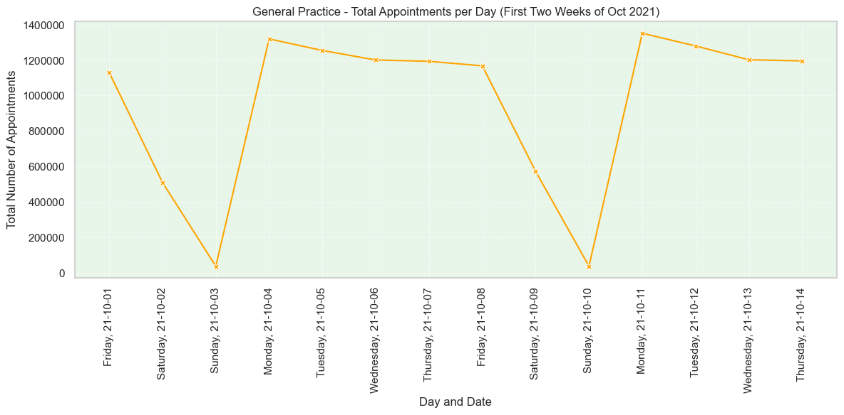
WEEKEND ANALYSIS
Weekend reduced availability / visits
Weekday increase : higher demand or service availability.
Mondays : Most appointments,
? weekend backlogs

Slide 9
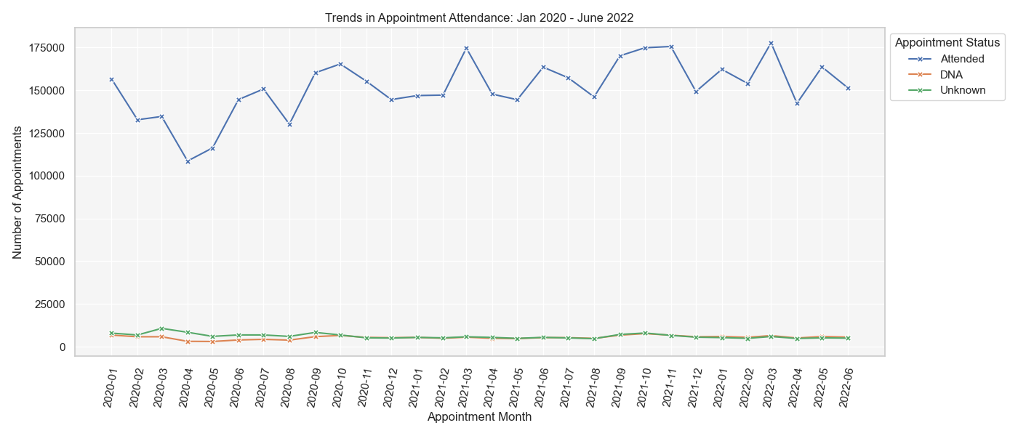
APPOINTMENT ATTENDANCE
Jan 20 – June 22
Attendance drop : Pandemic effect
Recovery : mid-2021
Increasing attendance despite fluctuations.
Most appointments : Attended

Slide 10
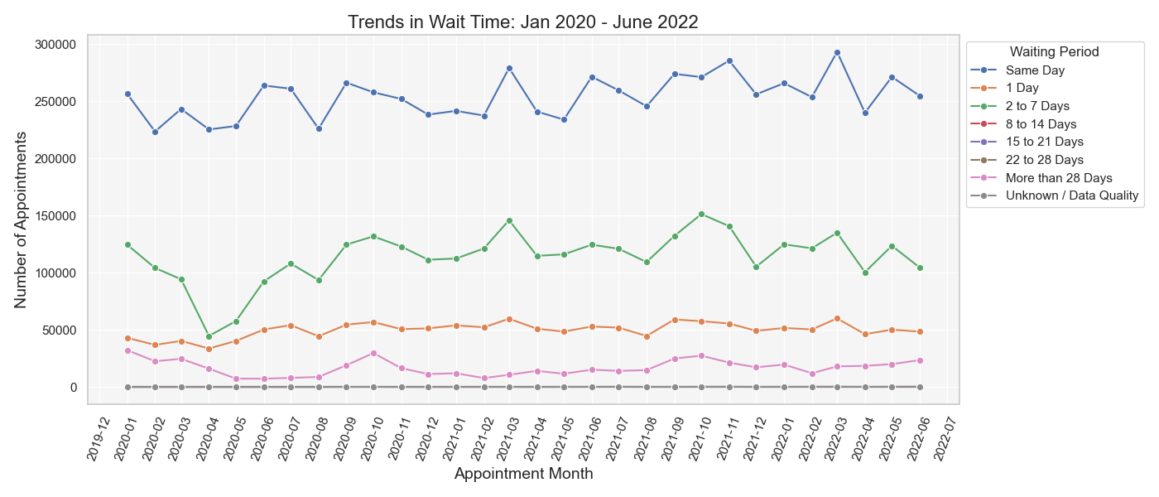
WAITING TIMES Jan 20 – June 22
Adaptability: GP practices maintained high same-day appointment levels in 20 despite pandemic
Waiting Times: Patients waited 2 to 7 days when same-day slots were unavailable; next-day appointments were rare

Slide 11
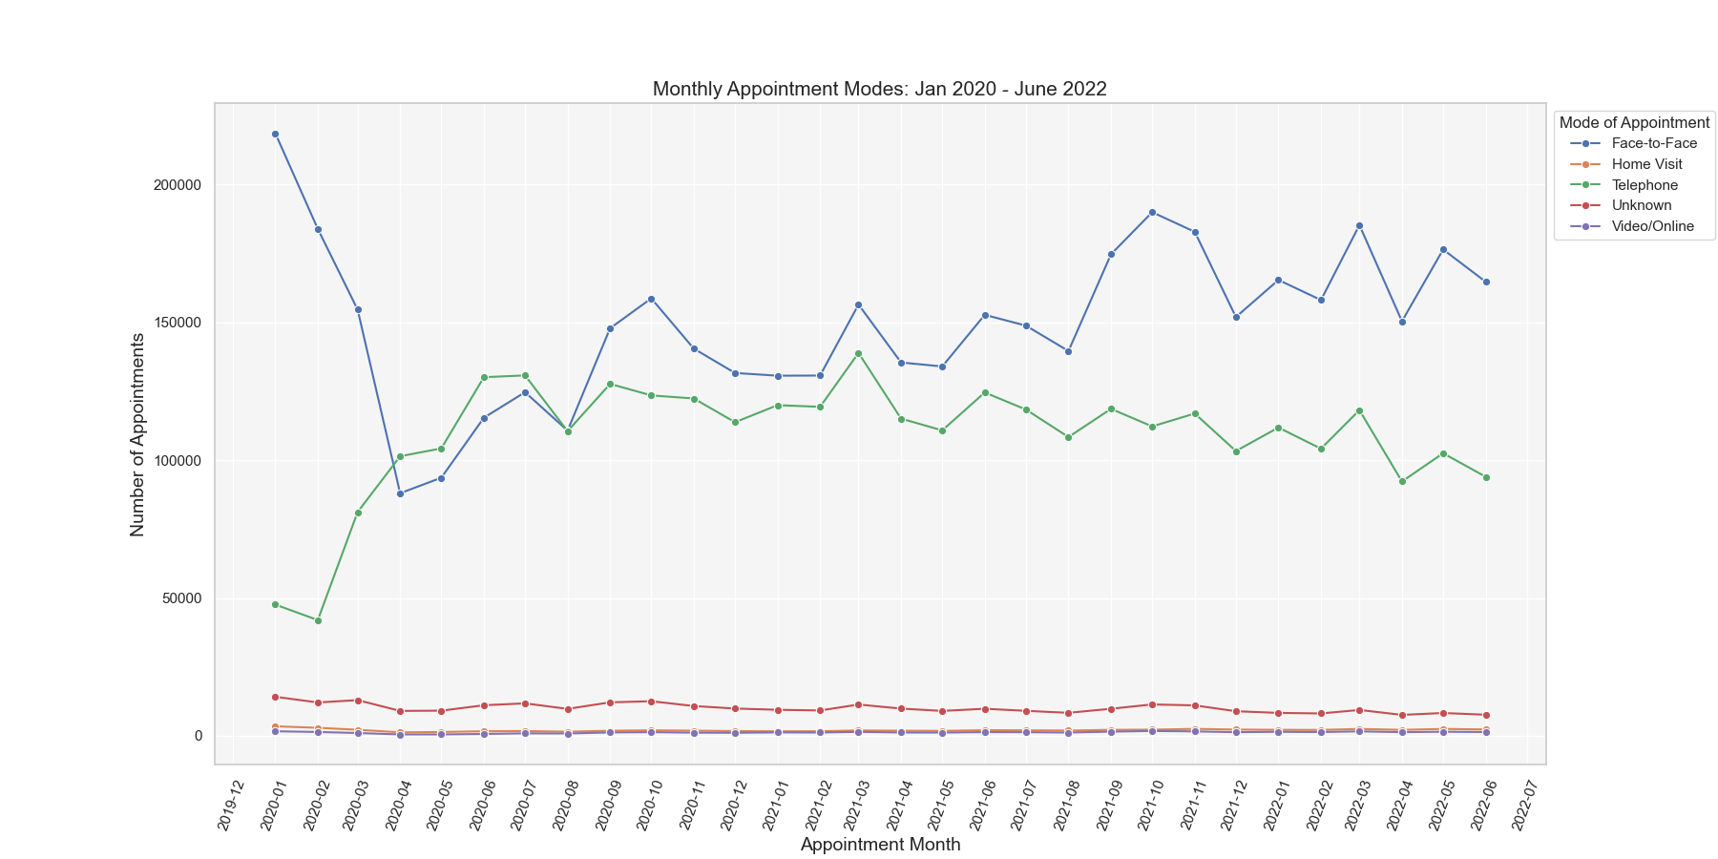
APPOINTMENT
MODE
Jan 20 – June 22
Shift: COVID-19 moved consultations from face-to-face to telephone.
Recovery: Face-to-face rebounded by late 2020 but stayed below pre-pandemic levels.
Telephone: Briefly surpassed face-to-face in mid-2020, then remained second.

Slide 12
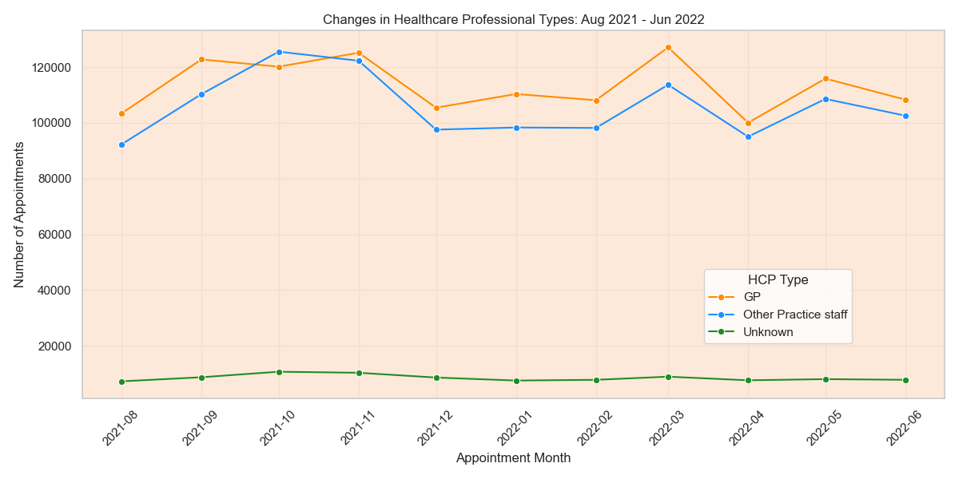
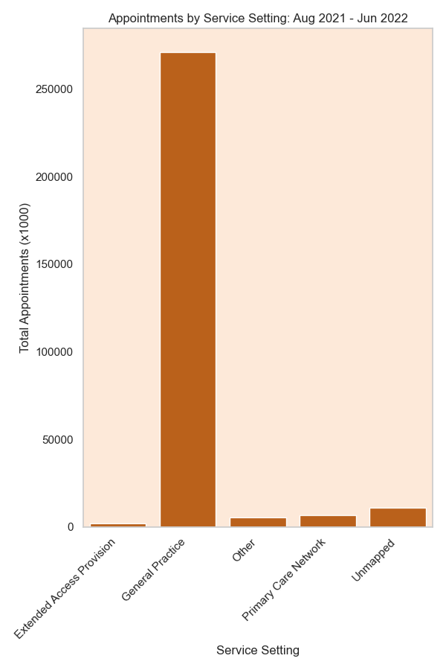
RESOURE
USE
GPs' Role: Handle 25x more appointments than PCNs and Extended Access; need for ongoing investment.
Staff Use: 'Other Practice Staff' briefly handled more appointments than GPs in Autumn 2021
Opportunity: Underused PCNs and Extended Access

Slide 13
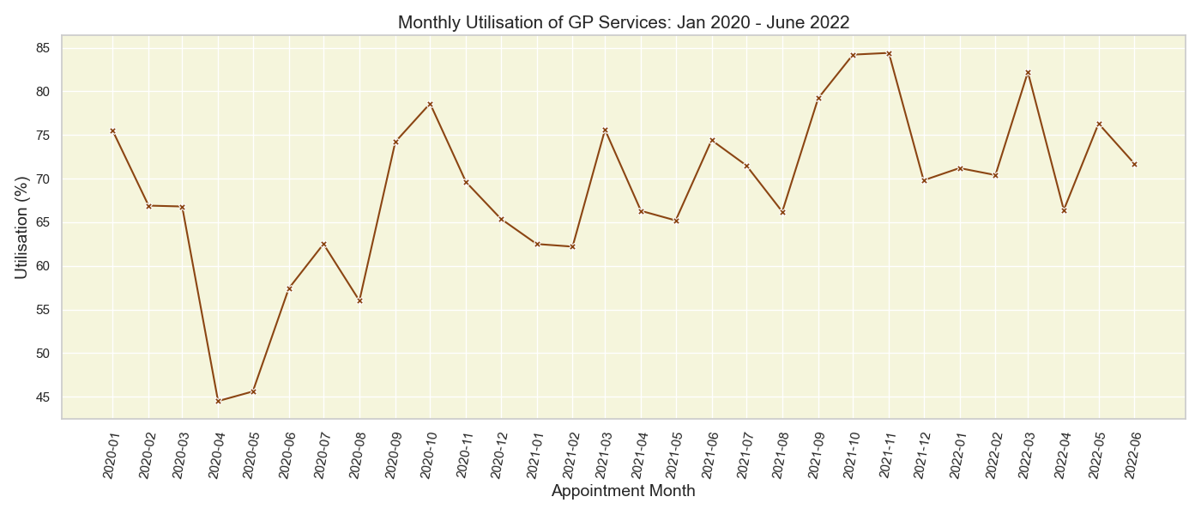
NHS Daily Appointment Target:
The NHS plans for 1.2 million appointments daily.
Future Utilisation Rates:
Future utilisation rates may fluctuate between 80-85%.
Peak Month Variations: Rates might rise during peak months.
Potential System Strain: Increased demand could strain the system.
NHS TARGET

Slide 14
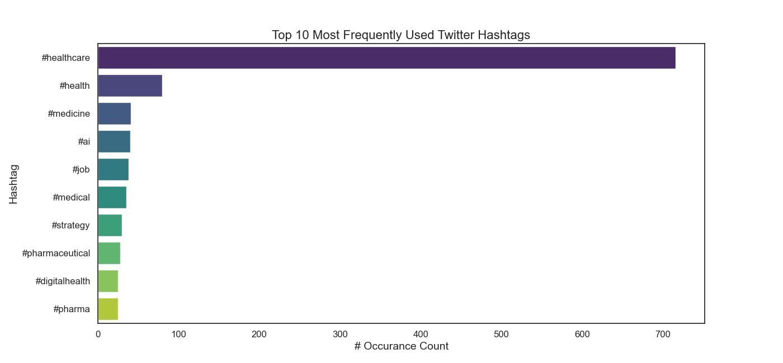
Lack of NHS Hashtags: The top 10 hashtags lack NHS or GP-related tags
Content Analysis: #healthcare tweets showed no focus on NHS issues.
Hashtag Strategy: Identifying and using relevant hashtags
TWITTER
DATA

Slide 15
RECOMMENDATIONS
1) Distribute appointment availability more evenly throughout the week:
Reduce high demand on Mondays.
Increase weekend availability.
Benefits: More patients served, attract staff for weekend shifts, and optimize GP shift patterns.
2) Increase "Primary Care Network" (PCN) appointments:
Follow NHS England guidelines for Enhanced Access.
Offer evening and weekend appointments.
Potential benefits: Reduced patient wait times, possible next-day appointments.
3) Expand consultation options beyond GPs:
Utilise qualified HCP professionals like practice nurses.
Reduce GP workload.

Slide 16
RECOMMENDATIONS cont.
4) Investigate decline in telephone appointments post-pandemic:
Determine causes (GP availability or patient choice).
Explore alternative methods like video consultations for suitable patients.
5) Utilise social media for awareness:
Use trending hashtags (e.g., #healthcare).
Assess public sentiment.
Encourage hashtags: #NHS, #NHScareers, #GPappointment, #WeekendGP.
6) Analyse COVID-19 impact:
Compare pre-COVID data with current data.
Assess progress and GP recovery from backlog.

Slide 17
THANK YOU

